Slide 1
Threads

Slide 2
Thread
Thread: single sequential flow of control within a program
Single-threaded program can handle one task at any time.
Multitasking allows single processor to run several concurrent threads.
Most modern operating systems support multitasking.

Slide 3
Thread Concepts
Traditionally a process has a single address space and a single thread of control to execute a program within that address space.
To execute a program, a process has to initialize and maintain state information.
The state information is comprised of page tables, swap image, file descriptors, outstanding I/O requests, saved register values etc. This information is maintained on a per program basis and thus a per process basis.
The volume of this information makes it expensive to create and maintain processes as well as to switch between them.
Threads or light weight processes have been proposed to handle situations where creating, maintaining and switching between processes occur frequently.

Slide 4
Multicore Programming
Multicore systems putting pressure on programmers, challenges include:
Dividing activities
Balance
Data splitting
Data dependency
Testing and debugging

Slide 5
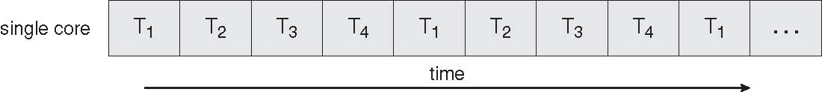
Concurrent Execution on a Single-core System

Slide 6
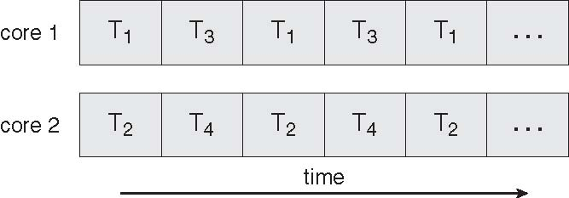
Parallel Execution on a Multicore System

Slide 7
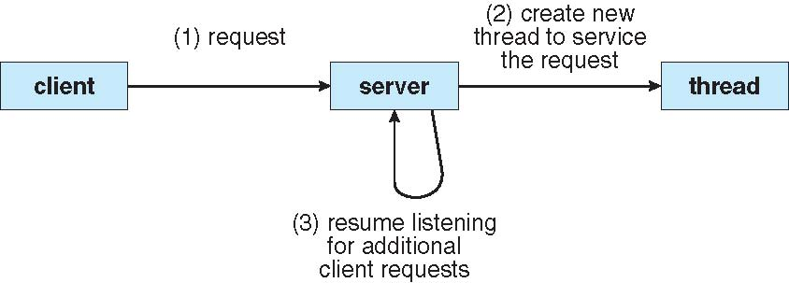
Multithreaded Server Architecture

Slide 8
Threads Concept
Multiple threads on multiple CPUs
Multiple threads sharing a single CPU

Slide 9
A process is an abstraction for representing resource allocation.
A thread is an abstraction for execution: a thread represents the execution of a particular sequence of instructions in a program's code, or equivalently a particular path through the program's flow of control.
A process may have multiple threads, each sharing the resources allocated to the process.

Slide 10
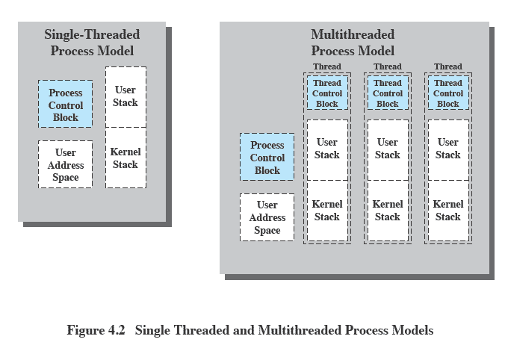
Threads vs Processes
Notes:
.

Slide 11
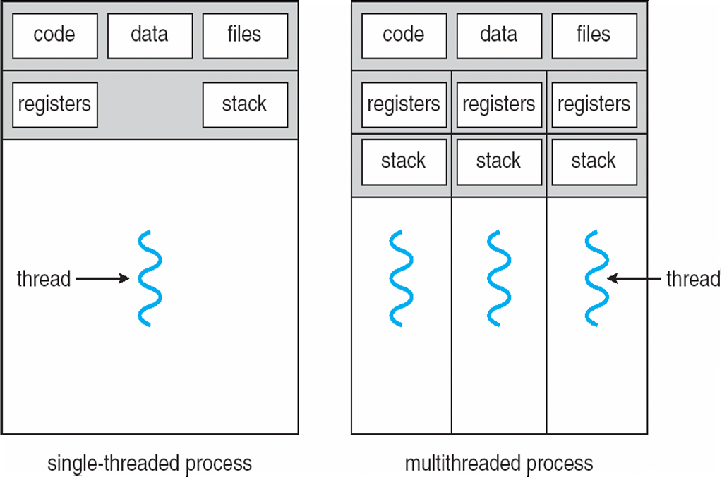
Single and Multithreaded Processes

Slide 12
A single thread executes a portion of a program, cooperating with other threads concurrently executing within the same address space. Each thread makes use of a separate program counter and a stack of activation records and a thread control block.
The control block contains the state information necessary for thread management, such as putting a thread into a ready list and for synchronizing with other threads.
Threads share all resources (memory, open files, etc.) of their parent process except the CPU.

Slide 13
The purpose of the thread abstraction is to simplify programming of logically parallel, cooperating activities; threads enable each activity to be implemented largely as a sequential program that shares resources with its peer threads.
But, since all threads in the same process share the process's resources, communication (and hence cooperation) among threads is easier to achieve than if each thread was a separate process.
Most of the information that is part of a process is common to all the threads executing within a single address space and hence maintenance is common to all threads.
By sharing common information overhead incurred in creating and maintaining information and the amount of information that needs to be saved when switching between threads of the same program is reduced significantly.

Slide 14
Each thread requires its own context:
program counter
stack
Registers
Each Thread has
an execution state (Running, Ready, etc.)
saved thread context when not running (TCB)
an execution stack
some per-thread static storage for local variables
access to the shared memory and resources of its process (all threads of a process share this)

Slide 15
Thread Execution States
Similar to a process a thread can be in any of the primary states: Running, Ready and Blocked.
The operations needed to change state are:
Spawn: new thread provided register context and stack pointer.
Block: event wait, save user registers, PC and stack pointer
Unblock: moved to ready state
Finish: deallocate register context and stacks.

Slide 16
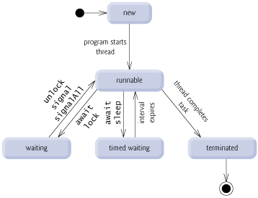
Thread States

Slide 17
Thread States

Slide 18
Thread Not Runnable
A thread becomes Not Runnable when one of these events occurs:
Its sleep method is invoked.
The thread calls the wait method to wait for a specific condition to be satisfied.
The thread is blocking on I/O.

Slide 19
Threads
In an OS that supports threads, scheduling and dispatching is done on a thread basis
Most of the state information dealing with execution is maintained in thread-level data structures
suspending a process involves suspending all threads of the process
termination of a process terminates all threads within the process

Slide 20
Thread Scheduling
An operating system’s thread scheduler determines which thread runs next.
Most operating systems use timeslicing for threads of equal priority.
Preemptive scheduling: when a thread of higher priority enters the running state, it preempts the current thread.
Starvation: Higher-priority threads can postpone (possible forever) the execution of lower-priority threads.

Slide 21
Thread Synchronization
It is necessary to synchronize the activities of the various threads
all threads of a process share the same address space and other resources
any alteration of a resource by one thread affects the other threads in the same process

Slide 22
Common Thread Models
User level threads
These threads implemented as user libraries. Thread library provides programmer with API for creating and managing threads. Benefits of this are no kernel modifications, flexible and low cost. The drawbacks are thread may block entire process and no parallelism.
Kernel level threads
Kernel directly supports multiple threads of control in a process. Benefits are scheduling/synchronization coordination, less overhead than process, suitable for parallel application. The drawbacks are more expensive than user-level threads and more overhead.
Light-Weight Processes (LWP)
It is a kernel supported user thread. LWP bound to kernel thread but a kernel thread may not be bound to an LWP. It is scheduled by kernel and user threads scheduled by library onto LWPs, so multiple LWPs per process.

Slide 23
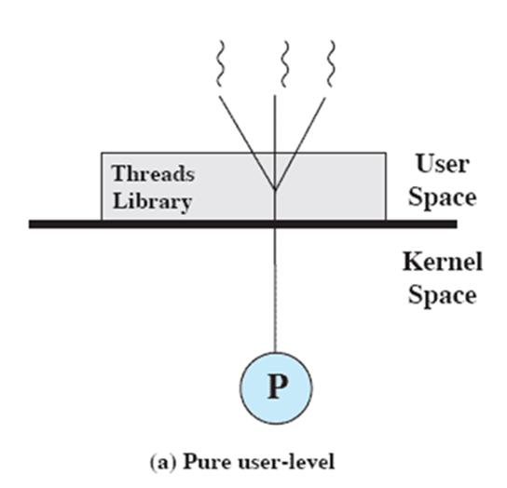
User-Level Threads (ULTs)
Thread management is done by the application
The kernel is not aware of the existence of threads

Slide 24
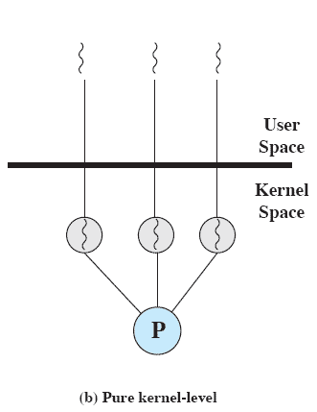
Kernel-Level Threads (KLTs)
Thread management is done by the kernel (could call them KMT)
No thread management is done by the application; Windows is an example of this approach

Slide 25
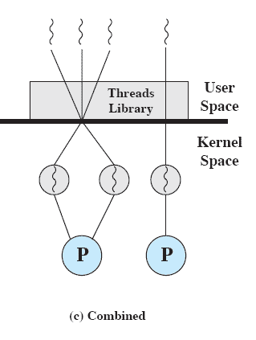
Combined Approaches
Thread creation is done in the user space
Bulk of scheduling and synchronization of threads is by the application
Solaris is an example

Slide 26
Multithreading
Kernels are generally multi-threaded.
Multi-threading models include
Many-to-One: Many user-level threads mapped to single kernel thread
One-to-One: Each user-level thread maps to kernel thread
Many-to-Many: Many user-level threads mapped to many kernel threads.

Slide 27
Many-to-One
Thread management is done by the thread library in user space
The entire process will block if a thread makes a blocking system call
Multiple threads may not run in parallel on multicore system because only one may be in kernel at a time
Few systems currently use this model
Mainly used in language systems, portable
libraries
Examples:
Solaris Green Threads
GNU Portable Threads

Slide 28
Advantages:
totally portable
easy to do with few systems dependencies
Disadvantages:
cannot take advantage of parallelism
may have to block for synchronous I/O

Slide 29
One-to-One

Slide 30
Each user-level thread maps to kernel thread
Creating a user-level thread creates a kernel thread
This is a drawback to this model; creating a user thread requires creating the corresponding kernel thread, and a large number of kernel threads may burden the performance of a system.
More concurrency than many-to-one
Allows another thread to run when a thread makes a blocking system call
It also allows multiple threads to run in parallel on multiprocessors.
Number of threads per process sometimes restricted due to overhead
Used in LinuxThreads and other systems where LWP creation is not too expensive

Slide 31
Advantages:
can exploit parallelism, blocking system calls
Disadvantages:
thread creation involves LWP creation
each thread takes up kernel resources
limiting the number of total threads

Slide 32
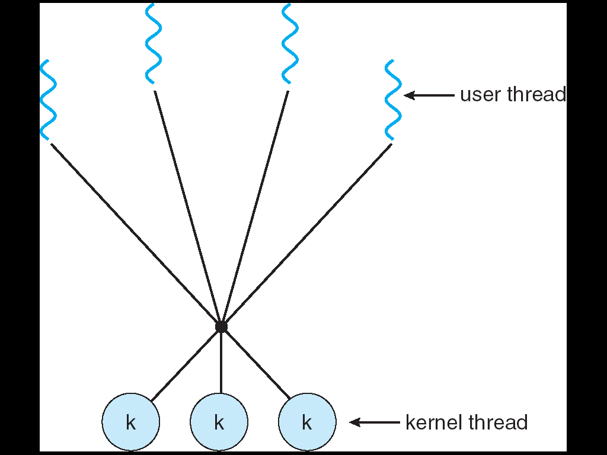
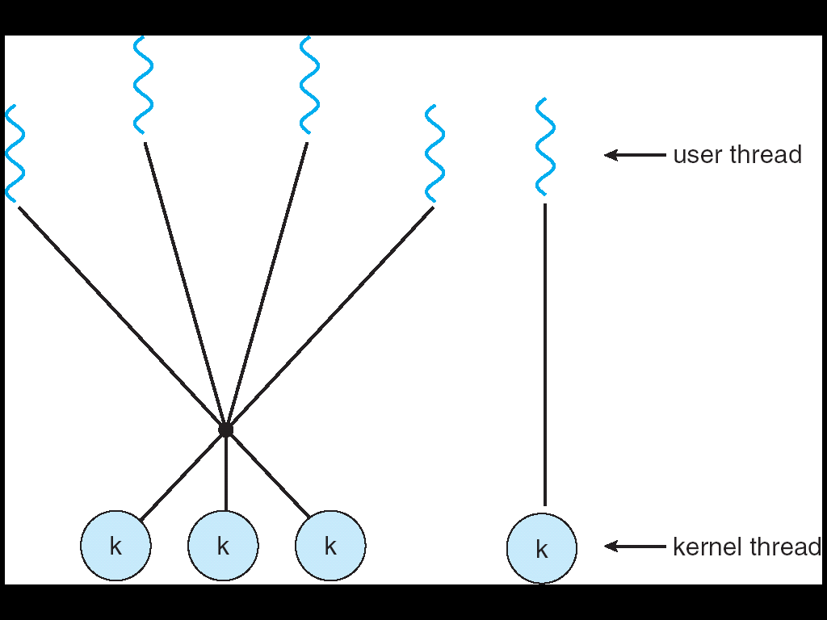
Many-to-many
In this model, the library has two kinds of threads: bound and unbound
bound threads are mapped each to a single lightweight process
unbound threads may be mapped to the same LWP

Slide 33
Allows many user level threads to be mapped to many kernel threads
Allows the operating system to create a sufficient number of kernel threads
The number of kernel threads may be specific to either a particular application or a particular machine
An application may be allocated more kernel threads on a system with eight processing cores than a system with four cores
Used in the Solaris implementation of Pthreads (and several other Unix implementations)
Windows with the ThreadFiber package
Otherwise not very common

Slide 34
Issues in multithreading include
Thread Creation
Thread Cancellation
Signal Handling (synchronous / asynchronous),
Handling thread-specific data and scheduler activations.

Slide 35
Thread pools
Create a number of threads in a pool where they await work
Advantages:
Usually slightly faster to service a request with an existing thread than create a new thread
Allows the number of threads in the application(s) to be bound to the size of the pool
Thread cancellation
Terminating a thread before it has finished
Two general approaches:
Asynchronous cancellation terminates the target thread immediately
Deferred cancellation allows the target thread to periodically check if it should be cancelled

Slide 36
Signal handling
Signals are used in UNIX systems to notify a process that a particular event has occurred
Signal is generated by particular event
Signal is delivered to a process
Signal is handled
Options:
Deliver the signal to the thread to which the signal applies
Deliver the signal to every thread in the process
Deliver the signal to certain threads in the process
Assign a specific threat to receive all signals for the process

Slide 37
Thread specific data
Allows each thread to have its own copy of data
Useful when you do not have control over the thread creation process (i.e., when using a thread pool)
Scheduler activations
Many : Many models require communication to maintain the appropriate number of kernel threads allocated to the application
Scheduler activations provide upcalls - a communication mechanism from the kernel to the thread library
This communication allows an application to maintain the correct number kernel threads

Slide 38
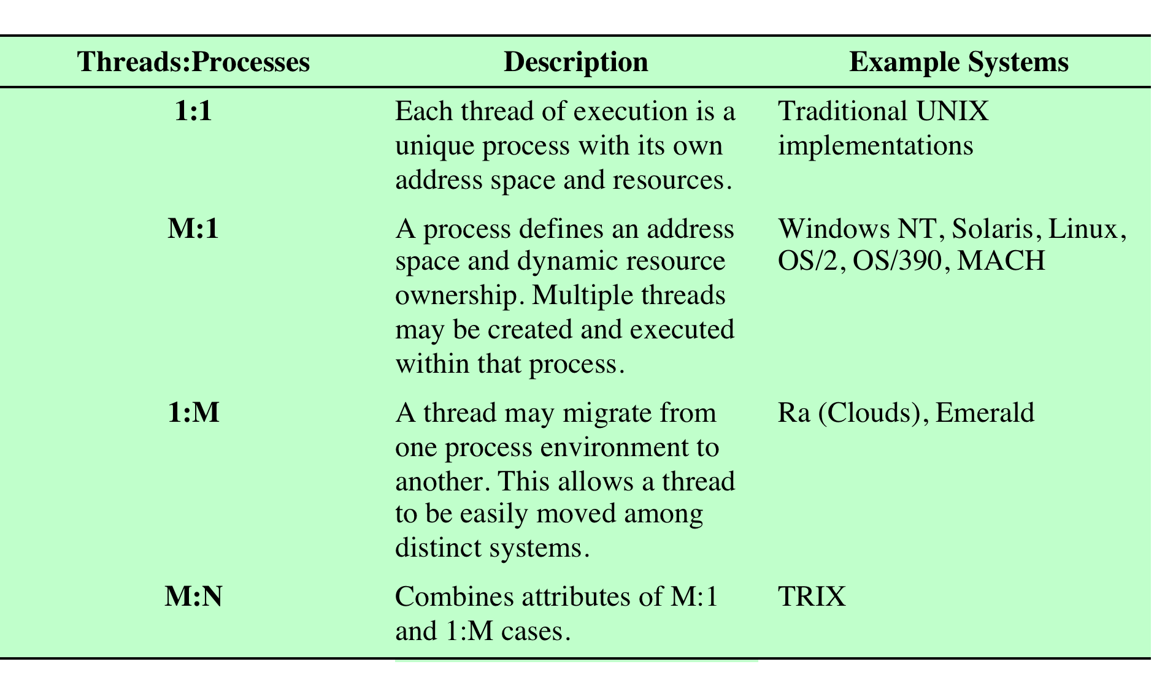
Relationship Between Threads and Processes

Slide 39
User Threads
Thread management done by user-level threads library
Examples
- POSIX Pthreads
- Mach C-threads
- Solaris threads
Supported by the Kernel
Examples
- Windows 95/98/NT/2000
- Solaris
- Tru64 UNIX
- BeOS
- Linux

Slide 40
Various Implementations
PThreads
A POSIX standard (IEEE 1003.1c) API for thread creation and synchronization
API specifies behavior of the thread library, implementation is up to development of the library
Common in UNIX operating systems (Solaris, Linux, Mac OS X)
Windows Threads
Implements the one-to-one mapping
Each thread contains
A thread id
Register set
Separate user and kernel stacks
Private data storage area
The register set, stacks, and private storage area are known as the context of the threads

Slide 41
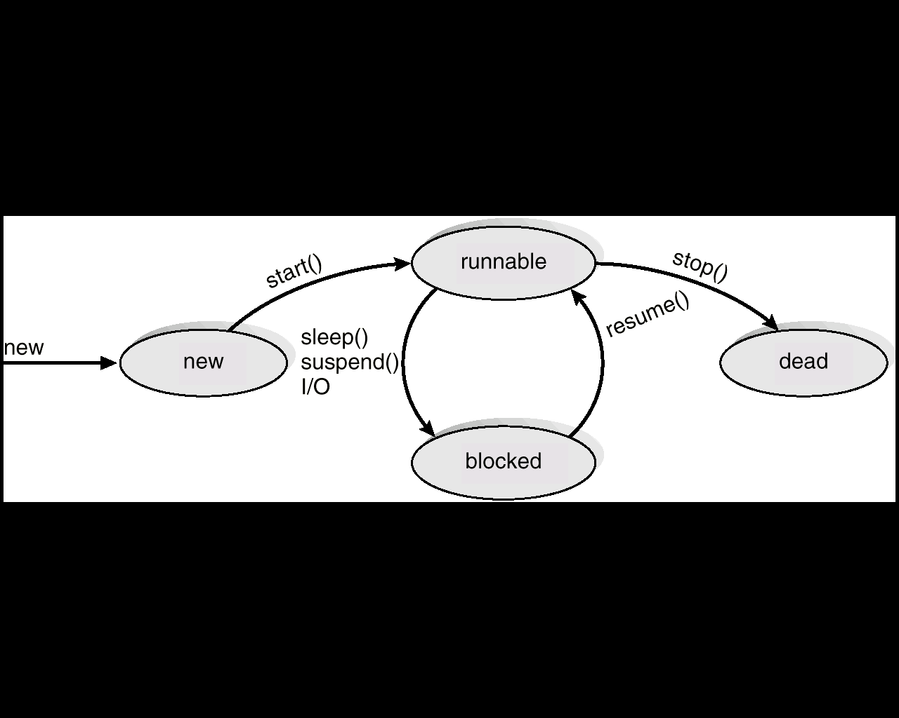
Various Implementations
Linux Threads
Linux refers to them as tasks rather than threads
Thread creation is done through clone() system call
clone() allows a child task to share the address space of the parent task (process)
Java Threads
Java threads may be created by:
Extending Thread class
Implementing the Runnable interface
Java threads are managed by the JVM.

